Slide 1
Introduction to DocuSign
UC Campuses and Electronic Signatures
Jill Cozen-Harel
DocuSign Introduction
UCCSC
July 8, 2014

Slide 2
What is DocuSign?
DocuSign is a web-based electronic signature and workflow management application.
It is becoming the UCSF campus solution for signatures and will significantly speed up processes that require signatures.
PAIN POINT: The current process of printing a form, signing it, scanning it, and then emailing it takes up too much administrative time and decreases efficiency.

Slide 3
How is DocuSign being used so far at UCSF?
1. Business Processes
Subcontract invoice pilot with Controllers Office & research departments
HR Retired Rehire web form process (UCOP forms)
IT Field Services exemption forms
IT Security – encryption variance request forms
IT Procurement for Mission Bay Hospital
Contracts
Academic research attestation forms (API integration with ServiceNow)
2. Signing documents on an individual basis

Slide 4
DocuSign envelopes sent at UCSF: Past 6 months

Slide 5
DocuSign as a campus application
Internet2 is finishing up a 9-month service validation program with DocuSign
UCSF is the only UC school participating with an enterprise license
Other campuses include OSU, ASU, Cornell, Univ. of Alaska, UW
The Service Validation Program evaluates implementation of campus use cases, addresses legal, contract and pricing topics, as well as both reasons for adoption and barriers to entry

Slide 6
Benefits thus far:
Functional
All users in workflow (sender, signer, recipient) can view real-time tracking status
Automatic reminders (optional) and expiration date
Allows for parallel, sequential, or mixed routing
Process
Substantial decrease in time elapsed between when a document is sent for signature, signed, and then returned
Departments and business units are forced to rethink their processes and discover that steps can be eliminated and efficiency, therefore, increased

Slide 7
Challenges thus far:
Shibboleth/SSO
DocuSign uses Okta, a third party, to implement SSO with shibboleth – that can cause account life cycle issues.
There is no automated de-provisioning process
Email is the primary identifier – this can create identity issues if the user’s email address needs to be changed
Users with pre-existing accounts
Guidance: To close users’ pre-existing account(s) in order to provision them into UCSF enterprise account smoothly and eliminate misdirection of documents
Challenge: DocuSign customer service is designed to interact with the end user for account closures and some other issues; we are trying to have our own UC staff act a shelter for UCSF users to DocuSign support

Slide 8
Challenges thus far:
Lack of delegation functionality
Sender does not receive out-of-office auto-reply generated by Outlook or other email client
Workaround – to share DocuSign folders in advance with coworker(s)
Lack of integration with Active Directory
Only UCSF DocuSign users are in address book when sending from DocuSign
Not able to integrate address book with standard directory services such as Active Directory or LDAP

Slide 9
Open decision topics:
Just in time or batch provisioning of all campus users
Just in time:
Only users who want to use DocuSign are provisioned signing-only accounts on demand, when they log in through MyAccess (our IdP).
Sender accounts currently provisioned only through submitting a ServiceNow ticket (manual change to user account by account admin)
Batch provisioning:
Upload large group of users through API using silent activation.
All users have accounts in advance and therefore are already in address book for auto-fill when sending
De-provisioning accounts
Why de-provision? Why not? No built-in process but does it matter?

Slide 10
Demo
Sending
Signing
Completion Notification
https://www.docusign.net/

Slide 11
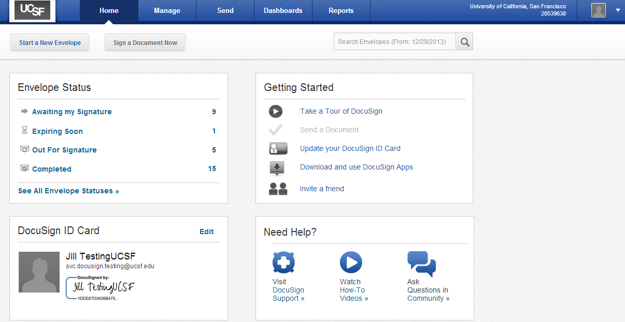

Slide 12
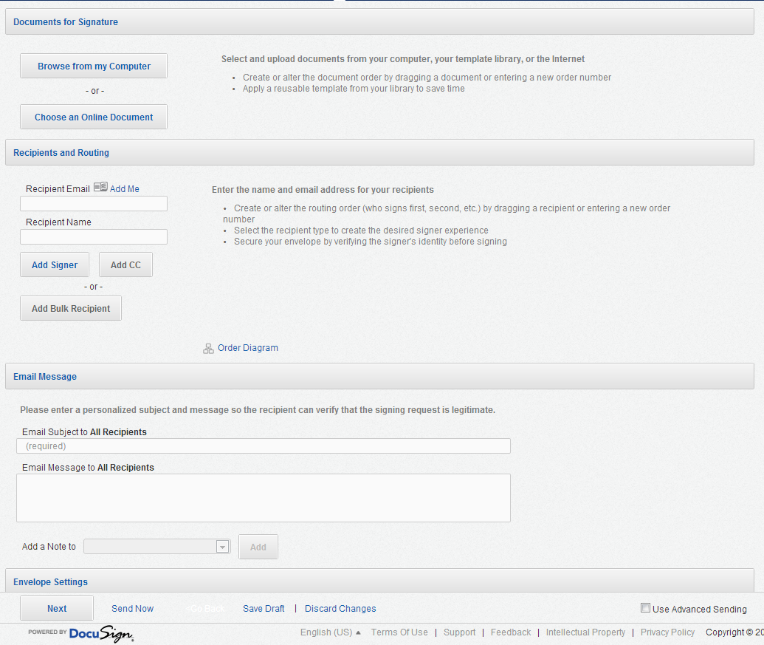

Slide 13
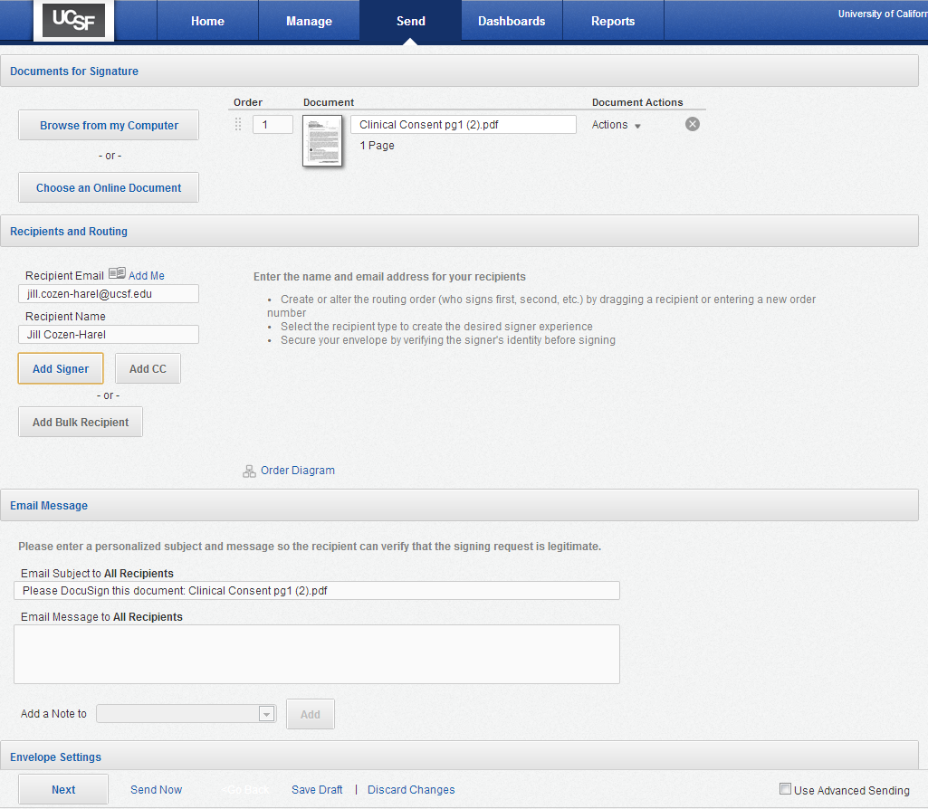

Slide 14
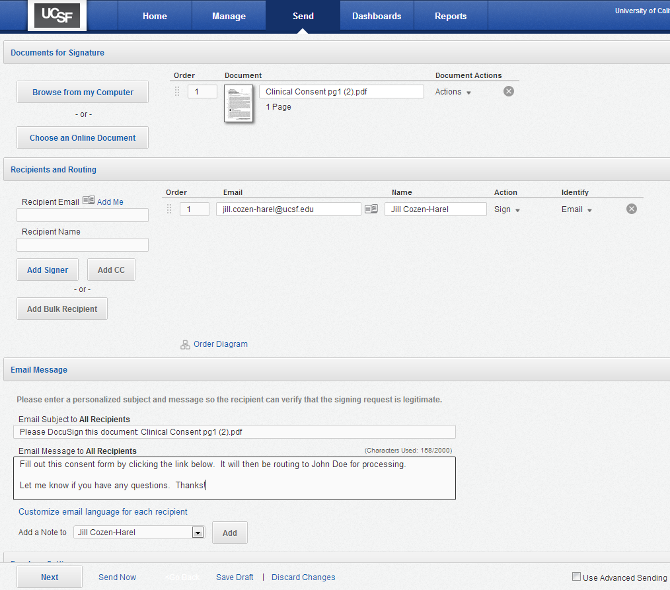

Slide 15
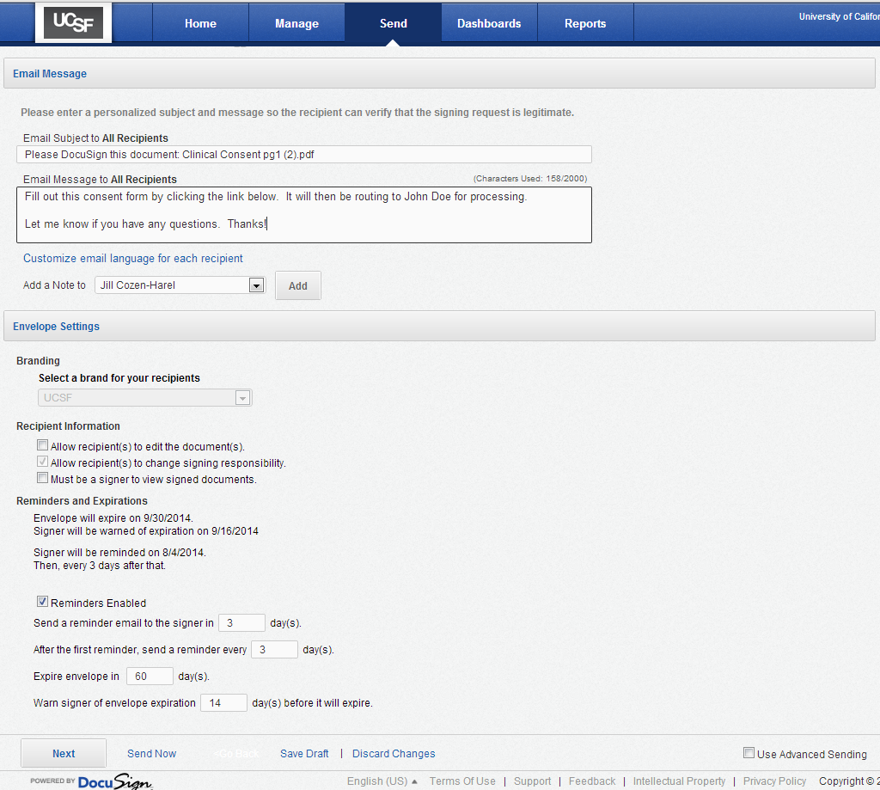

Slide 16
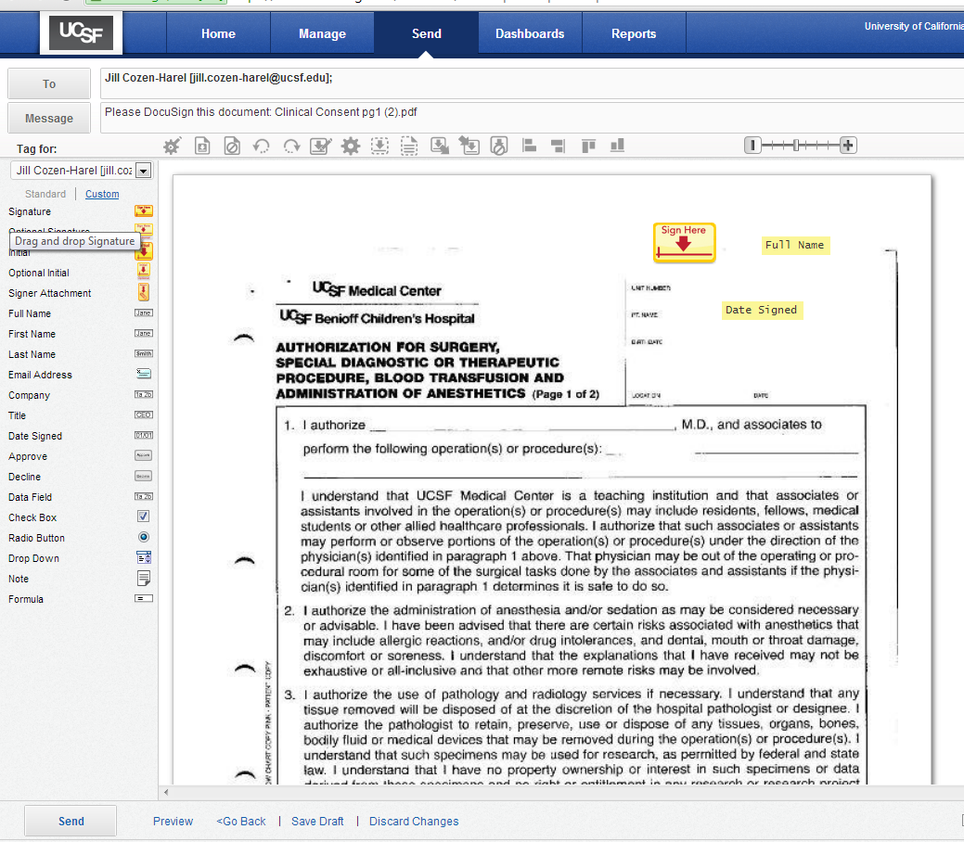

Slide 17
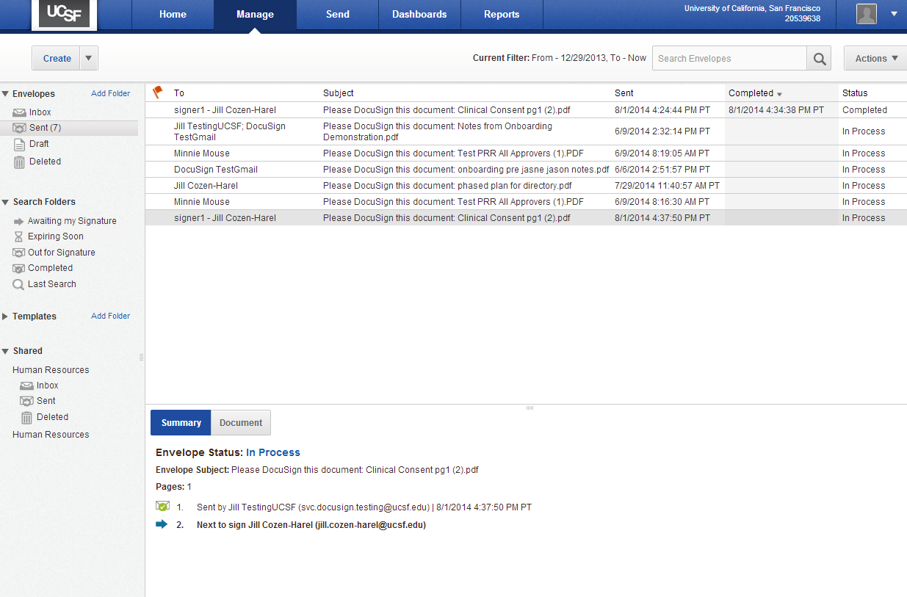

Slide 18
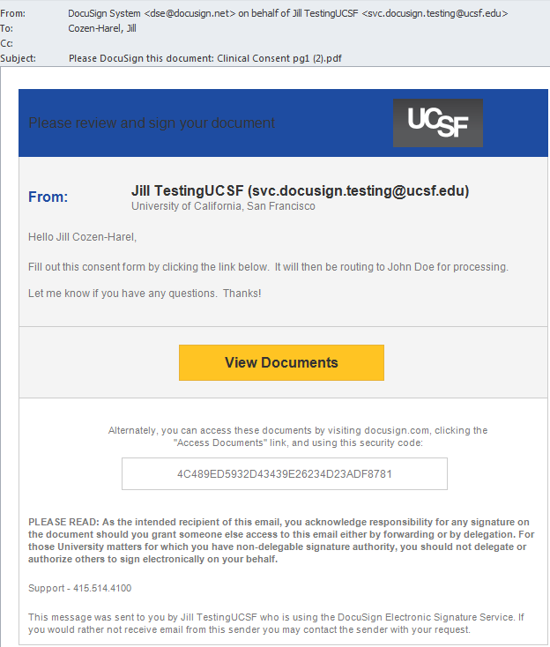

Slide 19
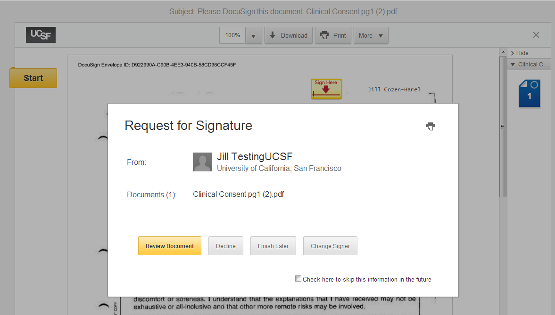

Slide 20
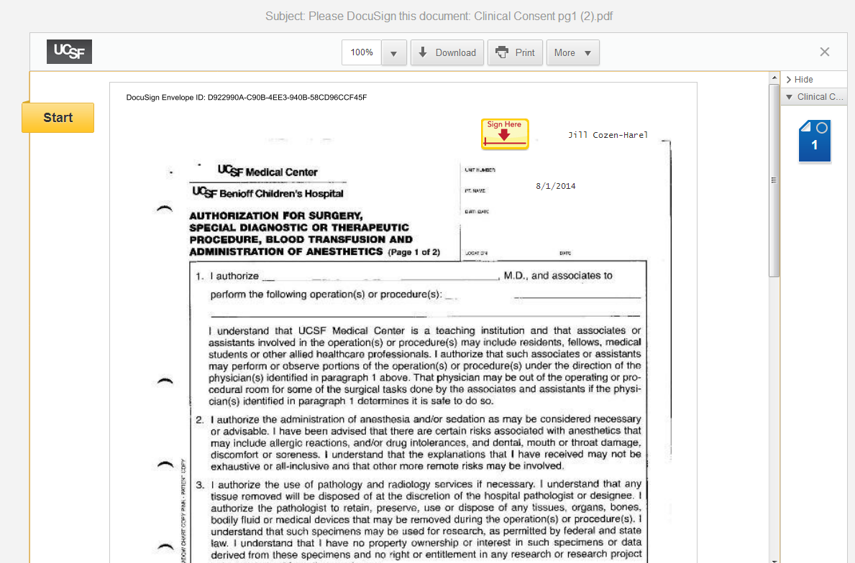

Slide 21
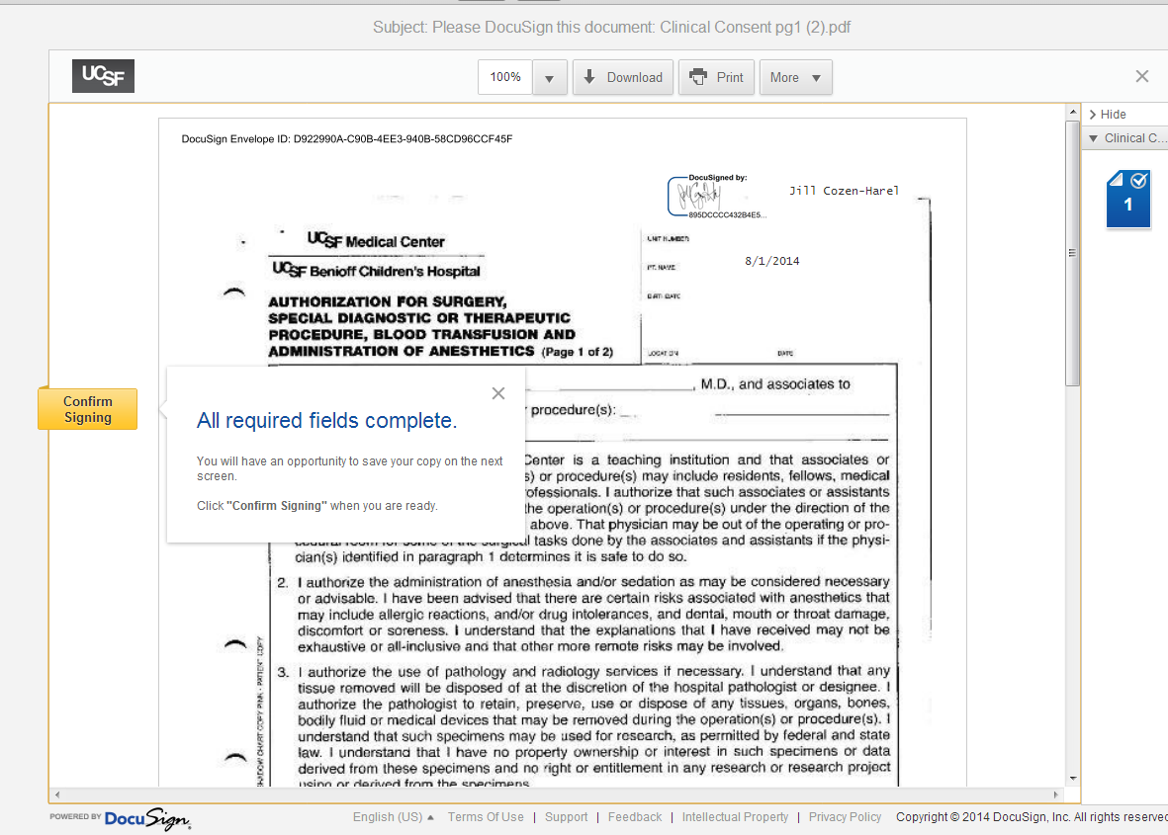

Slide 22
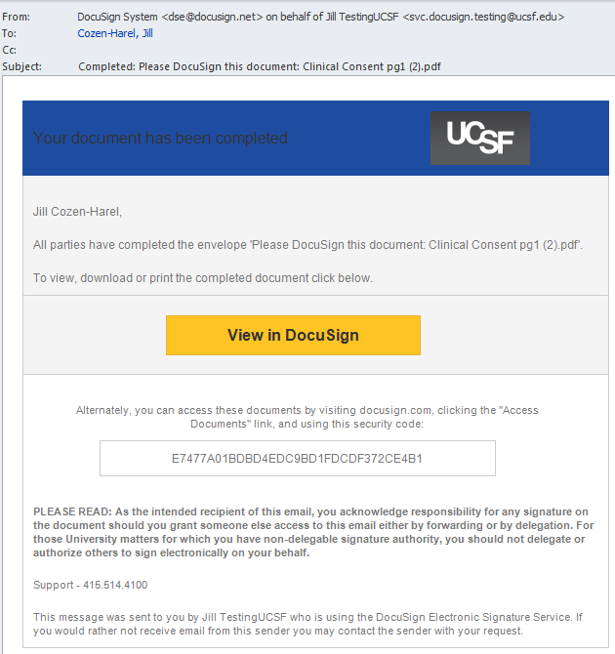

Slide 23
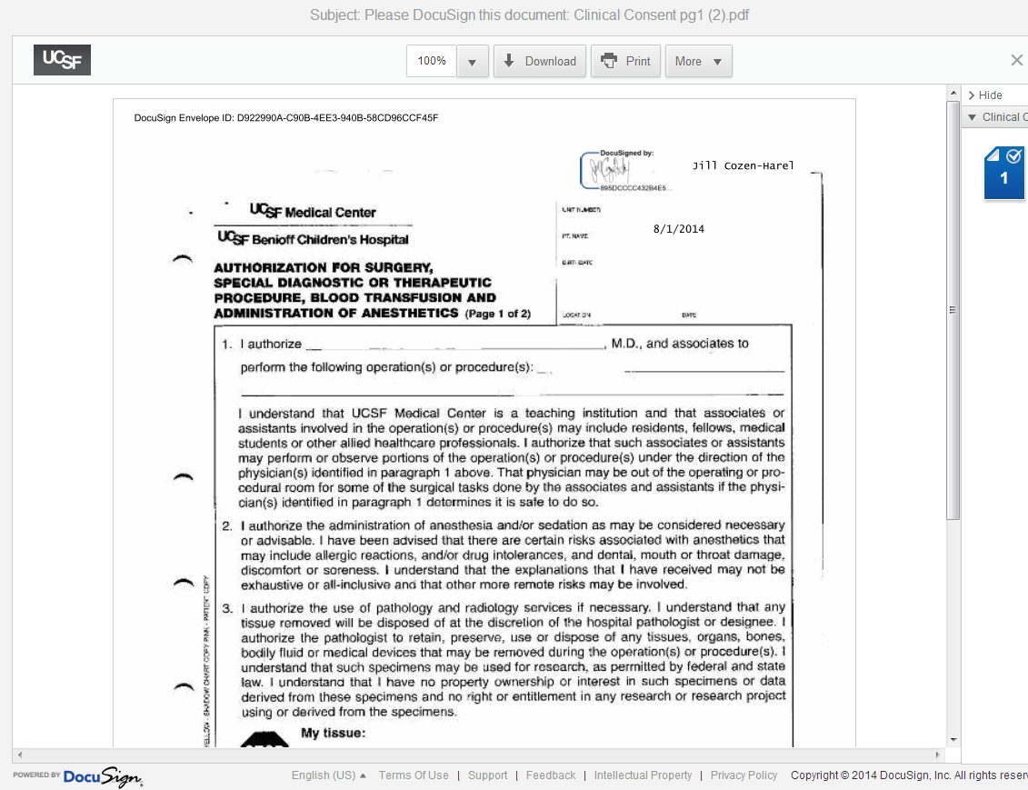

Slide 24
Questions? Answers.
Jill Cozen-Harel, DocuSign Lead/Business Analyst, UCSF
and
Seth Wills, DocuSign Senior Account Executive, Higher Education
UCSF DocuSign webpage:
https://it.ucsf.edu/services/electronic-signature-docusign/
For more information, email jill.cozen-harel@ucsf.edu for UCSF-related topics or, on other campuses, contact Internet2 directly

